Slide 1
CLASS 6 COMPUTER SCIENCE
Mobile Apps & Android
Understanding apps, websites, Android OS, and how to install applications safely

Slide 2

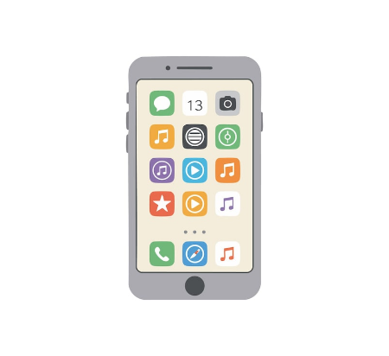
What is an App?
"App" stands for Application Software.
Smart Tool: Built for phones and tablets
Specific Tasks: Helps play games or study
Easy Access: Opens with a single tap

Slide 3
App vs. Website
Feature | Mobile App | Website
Installation | Downloaded from App Store | Opened in Web Browser
Internet Need | Many work offline too | Requires active internet
Speed | Faster device performance | Depends on browser speed
Device Access | Uses camera and GPS directly | Limited hardware access

Slide 4



Types of Apps
Mobile App
Desktop App
Web App
Built for smartphones and tablets.
Installed on laptops and computers.
Run inside web browsers online.

Slide 5



Popular App Categories
Education
Communication
Duolingo, Google Classroom, Khan Academy
WhatsApp, Zoom, Google Meet
Entertainment
Utility
YouTube, Spotify, Minecraft
Calculator, Google Maps, Clock

Slide 6
PART TWO
Exploring Android

Slide 7

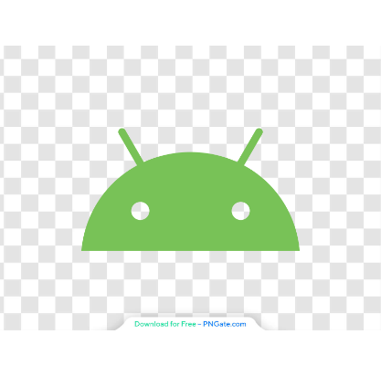
What is Android?
The main software (OS) that runs a smartphone.
Device Brain: Connects screen, battery, and apps together
Made by Google: Built on the free Linux system
Touch Control: Lets you tap, swipe, and run apps

Slide 8
Versions of Android OS
Version & Name | Year | Key Feature
Android 1.5 (Cupcake) | 2009 | Introduced on-screen keyboard and widgets
Android 4.4 (KitKat) | 2013 | Added "OK Google" voice assistant
Android 8.0 (Oreo) | 2017 | Added Picture-in-Picture mode and faster boot
Android 10 | 2019 | Introduced system-wide Dark Mode and gestures
Android 12 | 2021 | Launched Material You colorful custom themes
Android 15 | 2024 | Added Private Space and stronger theft protection

Slide 9




Devices Android Supports
Smartphones
Tablets
Smart TVs
Smartwatches
Samsung, Pixel, OnePlus phones
Large screens for study
Android TV streaming boxes
Wear OS fitness trackers

Slide 10
Characteristics of Android
Open Source: Free for companies to customize
Customizable UI: Change wallpapers, widgets, and themes
Multitasking: Run multiple apps side by side
Google Integration: Built-in Gmail, Maps, and Drive

Slide 11




How to Check Android Version
1. Open Settings
2. About Phone
3. Software Info
4. View Number
Tap the gear icon
Scroll to bottom menu
Select Android version
See current OS number

Slide 12


Download and Install an App
01
Open Google Play Store on your device
02
Type the app name in the Search bar
03
Tap the green Install button
04
Tap Open once download finishes

Slide 13

Thank You!
Any questions about Apps or Android?

Slide 14



Image Sources
https://img.magnific.com/premium-vector/smartphone-device-with-colorful-app-icons-screen-flat-vector-illustration-technology-communication-graphic-design_854757-28856.jpg?semt=ais_hybrid&w=740&q=80
Source: www.magnific.com
https://pngate.com/wp-content/uploads/2025/06/android-icon-main-logo-symbol-android-green-robot-head-flat-design-1.png
Source: pngate.com
https://learningmole.com/wp-content/uploads/2025/08/v2-ljh6d-8r9kg.jpg
Source: learningmole.com

